Slide 1

Smart Agriculture System Using IoT
Sathya S
sath18304.cs@rmkec.ac.in

Slide 2
PROJECT AIM
The purpose of this project is to reduce the labor of Farmers making their work easy and simple with the help of IoT technology.

Slide 3
Technology Stack
IBM Cloud and IBM Watson IoT Platform
Node – red
OpenWeatherMap API
Python IDLE
With the combination of these technologies, an IoT controlled irrigation system is created.
The system displays the sensor information as well as forecast for the farmer to operate the irrigation system remotely from anywhere.

Slide 4
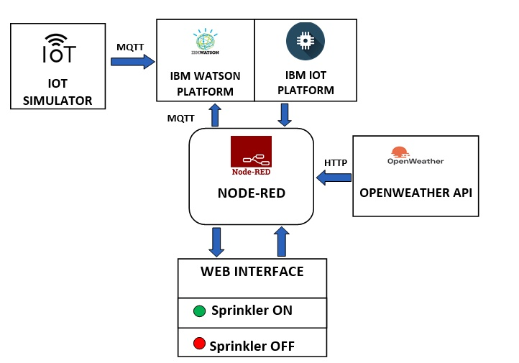
DATAFLOW
A device is created in the IBM platform to store the data
A Python code is run which subscribes the commands to the IBM device

Slide 5
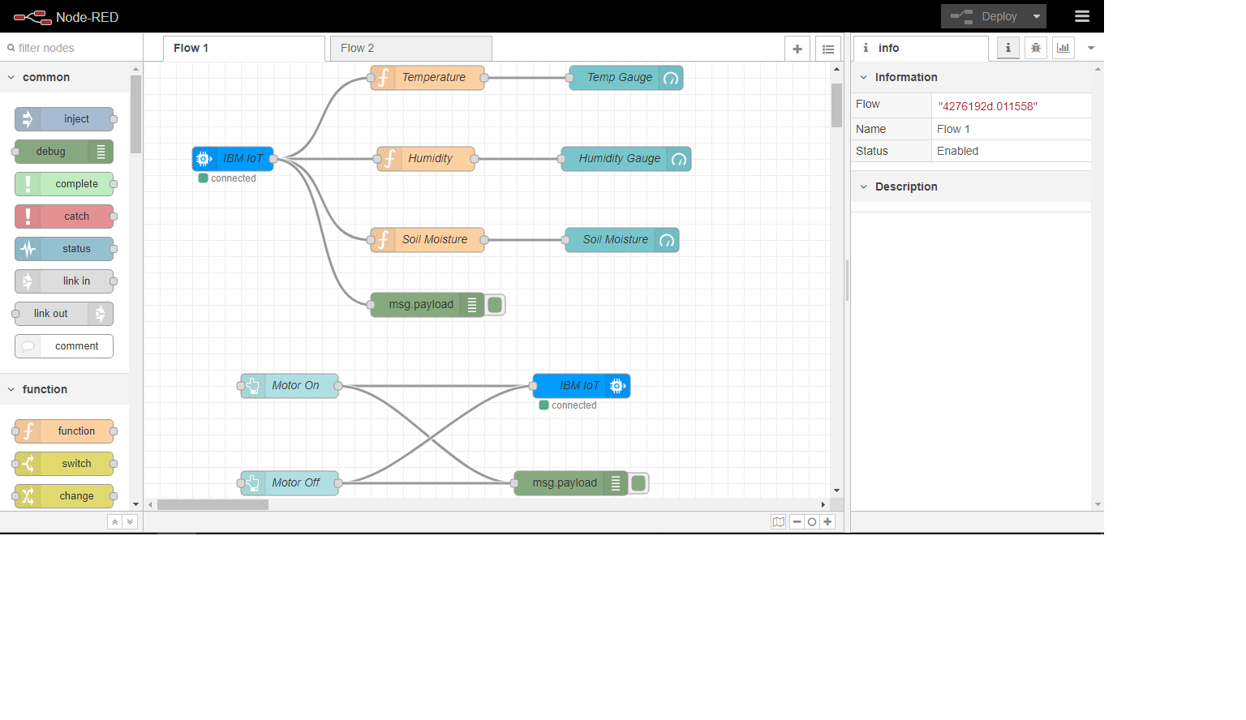
NODE-RED FLOW
Dashboard and IBM nodes are installed from the manage palate option.
The function and gauge nodes manipulate the device data and display it in an User-Interface.

Slide 6
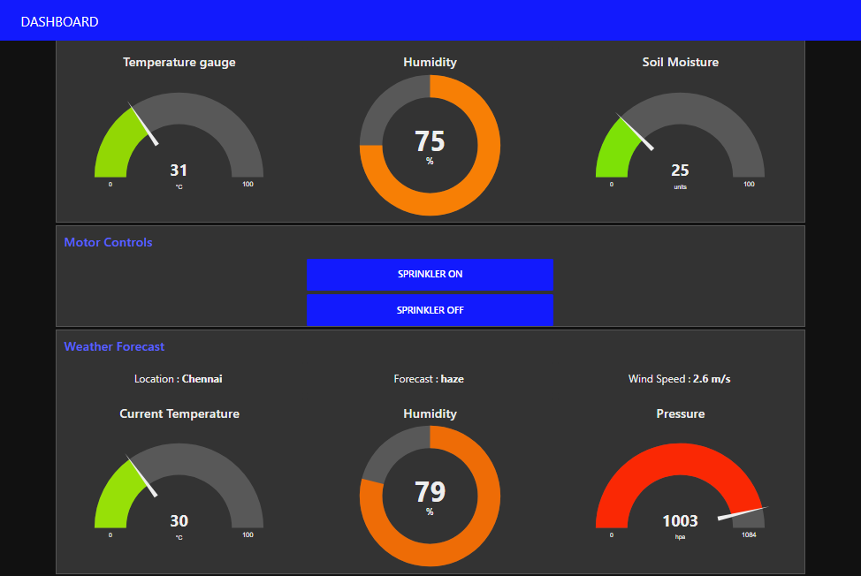
The dashboard where farmer can visualize and send commands

Slide 7
Thank you
Sathya S
sath18304.cs@rmkec.ac.in

